Slide 1
A DreamData Production
Presented by
Kiran Kokambe Shubhangi Jadhav
Aniket Kardile
Sandhya Sree Agolu

Slide 2
Smart Energy Meters
Energy Consumption on Watch!

Slide 3
World Energy Consumption
22,848 TWh!
That’s a 1.7% increase from previous year!!
The Top 3
Accounts for upto 40% of world energy consumption!
3% rise per year
Our energy demands grows about 3% every year!

Slide 4
The Solution
Real-time Visuals
Energy Alerts
live consumption graphs to to energy providers to adjust and meet demands
Analysis of streaming data to provide usage alerts to users
1
2
Make a difference!

Slide 5

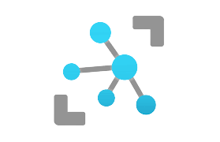





Power BI
Stream Analytics
Gmail
IoT Hub
Smart Meters
Azure Storage
Azure Databricks

Slide 6
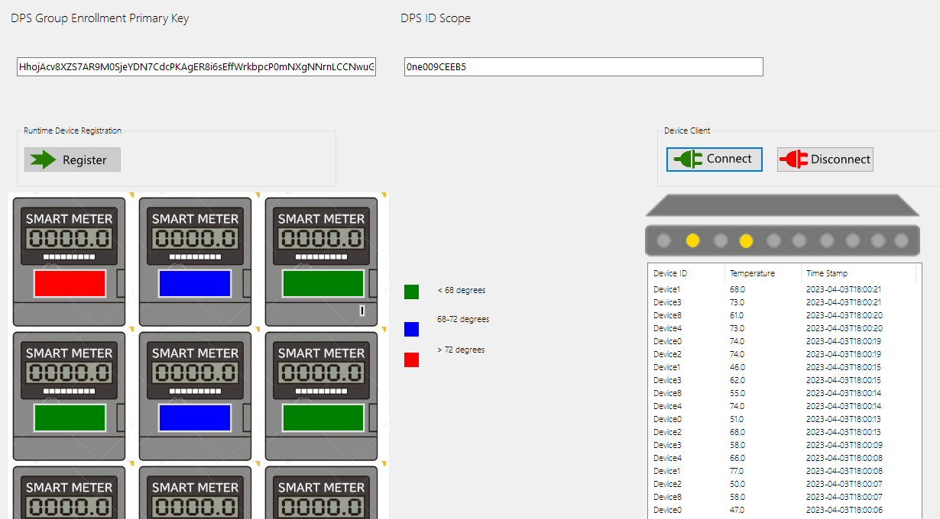
Data Source : Simulated Smart Meters
A simulation of Smart Meters is created to mimic real world data, which is then connected to Azure cloud via Azure IoT Hub.

Slide 7
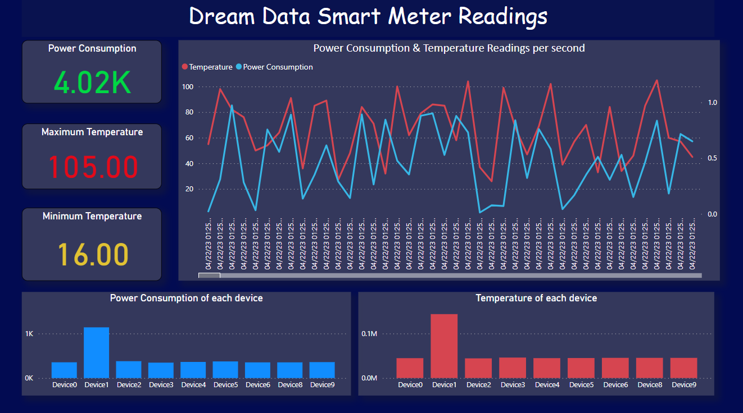
Hot Stream : Real time Data Monitoring
Data from IoT Hub is captured by Stream Analytics Job which feds the incoming stream to PowerBI dashboard in real time.

Slide 8
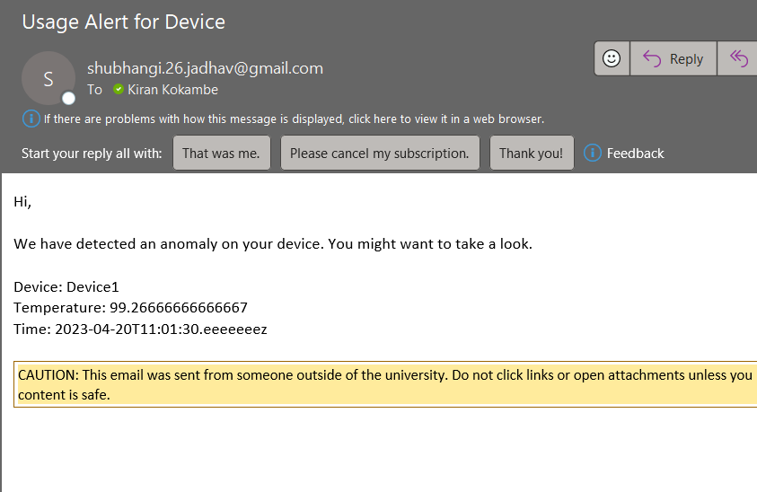
Event Stream : Real time Usage Alerts
Data from IoT Hub is captured by Stream Analytics Job which feds the incoming stream to Azure Event Hub which triggers a function app to send power usage alerts to users via Gmail.

Slide 9
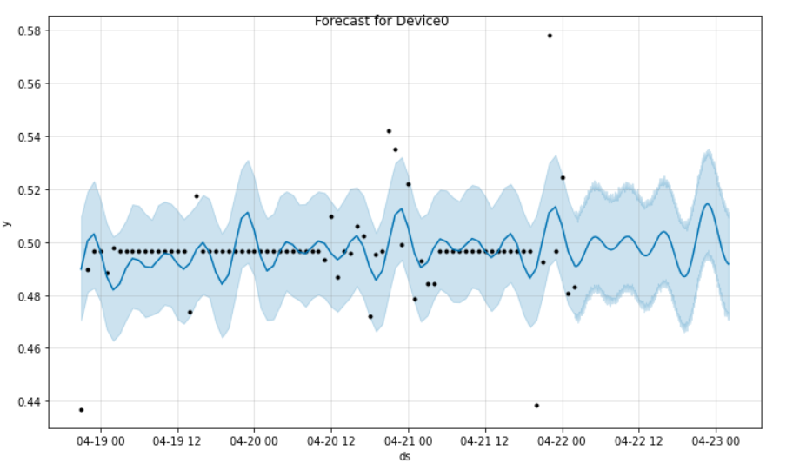
Cold Stream : Forecasting
Data from IoT Hub is captured by Stream Analytics Job which stores the incoming stream to Azure Blob Storage.
A forecasting model is built in Azure Databricks which retrieves data from storage and forecasts power consumption for the next 24 hours.

Slide 10
Advantages & Benefits
Energy Conservation
Improved Grid Efficiency
Accurate Billing
Better outage management
Improved Customer Engagement
Enable new services

Slide 11
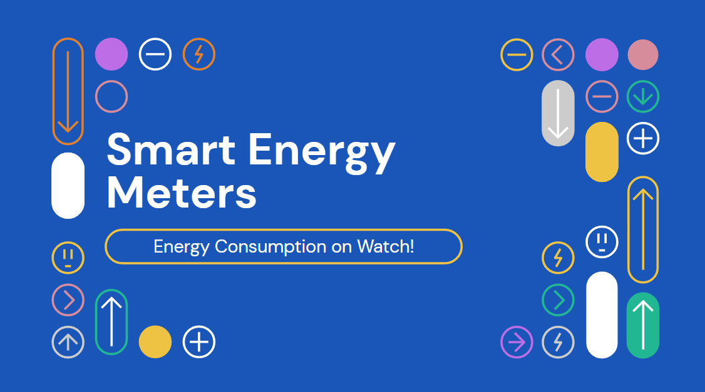
Thanks folks!
Questions?

